Slide 1
Next-generation Polarized ³He Targets for Electron Scattering Experiments
Dissertation Defense
Yunxiao Wang
University of Virginia
Special thanks to Maduka Kaluarachchi, Daniel Matyas, Yuan Zheng, Sumudu Katugampola, Vladimir Nelyubin, Al Tobias and Mike Souza
Advisor: Gordon Cates

Slide 2
Outline
³He targets
Spin-exchange optical pumping (SEOP)
³He polarimetry
Development of hybrid cells
Polarized ³He target cells incorporating metal

Slide 3
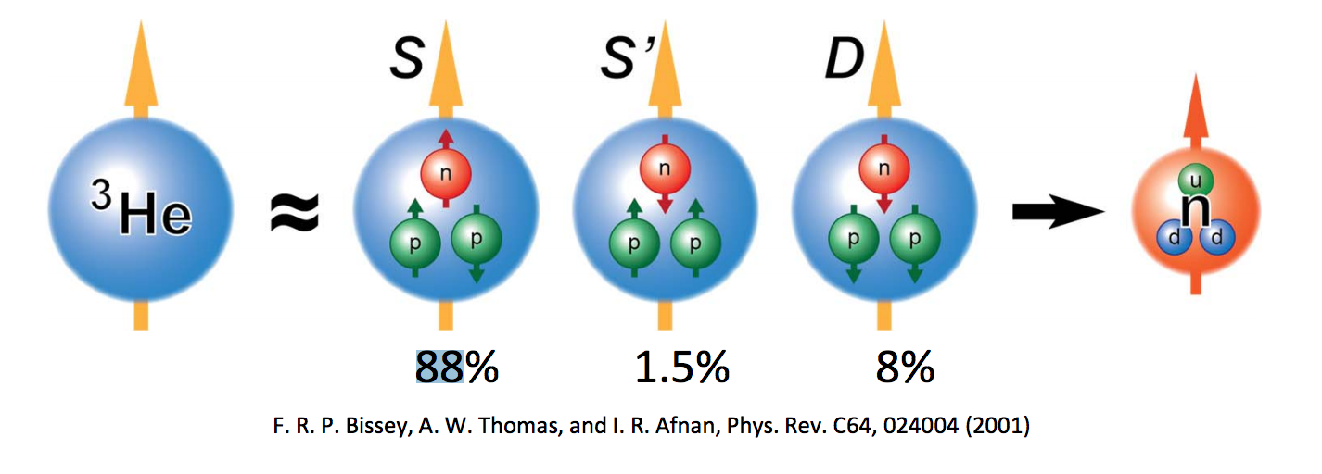
³He Target for studying neutron
Nuclear-polarized noble gases are very useful in various applications, such as electron scattering experiments, magnetic resonance imaging.
Polarized ³He is particularly useful for studying spin-dependent interactions involving neutrons.
Free neutrons are unstable, they decay in less than 15 minutes
To first order approximation, a ³He nucleus has two protons with paired spins, and a single neutron that accounts for most of the nuclear spin.
Notes:
Some notes

Slide 4
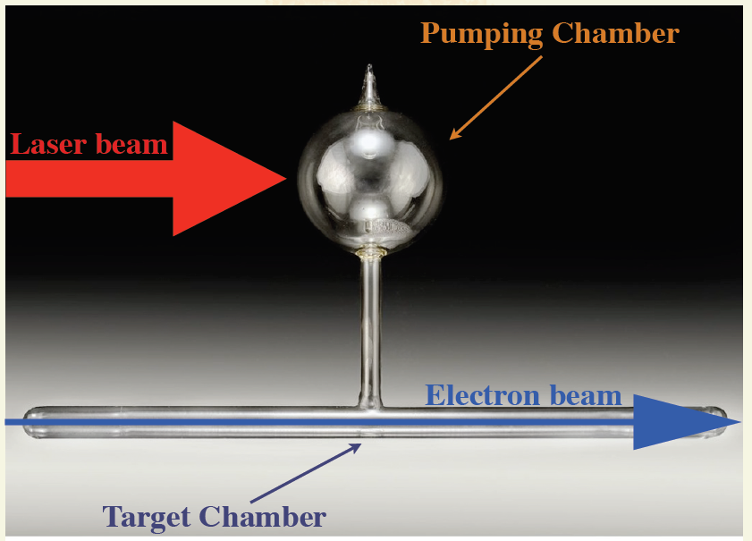
Traditional ³He target cell
Forced-Air Oven
Transfer Tube

Slide 5
Effective luminosity
In a double-spin asymmetry experiment, the measured asymmetry is
where
with L and t being luminosity and experiment duration, respectively
Effective luminosity
Notes:
Why High PHe is important?
Double-spin: polarized electrons are scattered off of polarized 3He atoms
N: the number of detected events
I_{beam}: electron beam current
e: the charge of the electron
[He]: He density
l: length of the target chamber

Slide 6
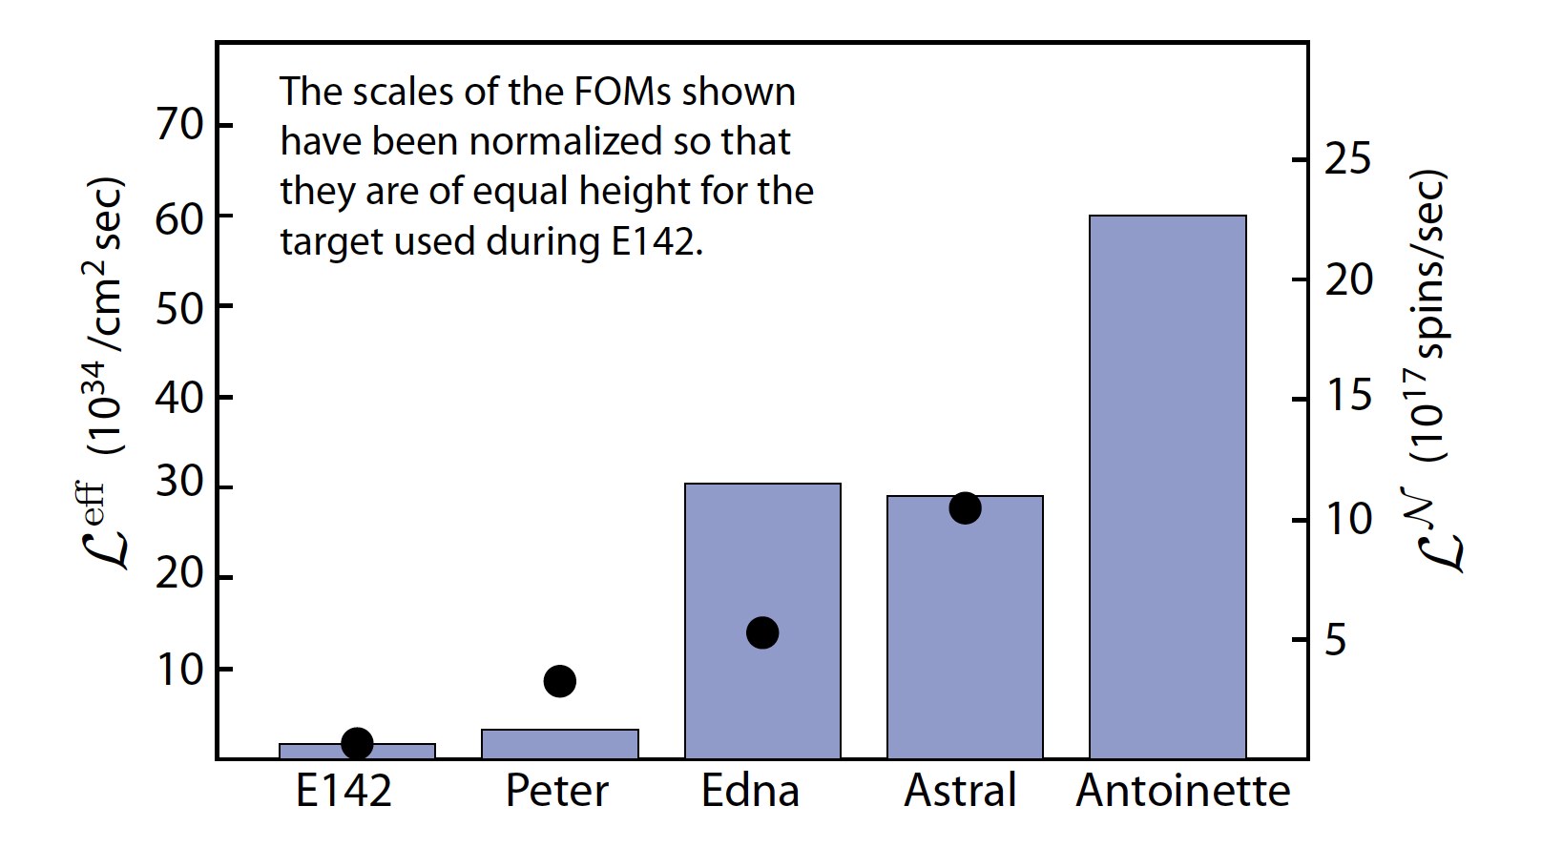
The performance of polarized ³He targets have increased by a factor of 30 since slac e142
Demonstrated by simulated beam test
Notes:
Left scale is for the black dots: luminosity weighted by Phe^2
Right scale is for the columns: number of spins polarized per second weighted by Phe^2

Slide 7
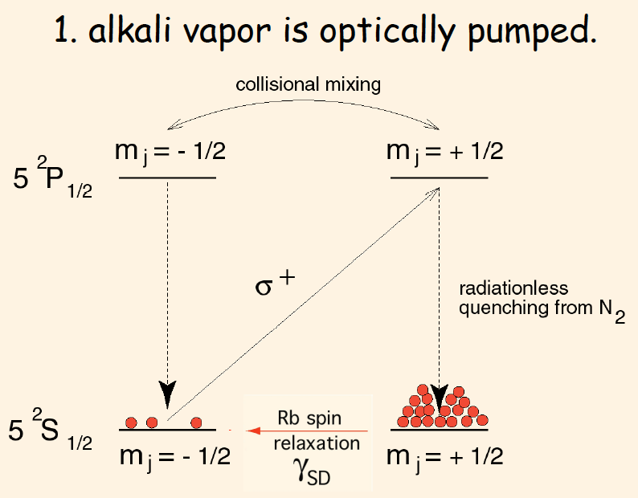
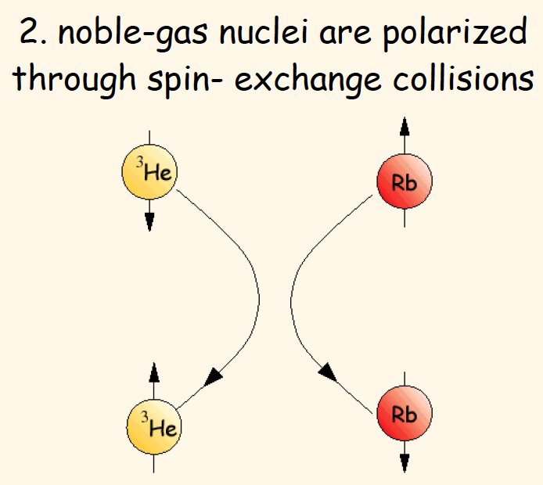
SPIN-exchange optical pumping (seop)
Notes:
Summarize the previous slides first:
Application of 3He targets, what a 3He target looks like, why high polarization, improvement of performance
Our group focuses on SEOP as MEOP polarizes gas at relatively low pressure (1
torr), thus further compression is required to produce target cells of several atms that
meet the need of JLab experiments.
A small amount of N2 gas is added into the cell (typically around 0.1 Amagats) to
non-radiatively quench the excited electrons as N2 molecules can absorb the released
energy of spontaneous decays into their rotational and vibrational modes of oscillation.

Slide 8
³He spin Relaxation
The total relaxation of 3He nucleus spin polarization due to all processes except for spin exchange:
Dipolar relaxation rate at 23C
Static field inhomogeneity
Wall relaxation
Notes:
D: diffusion constant, \nablaBx and \nablaBy are the transverse magnetic field inhomogeneities, B0 is the holding field
\rho is the so-called relaxivity, S/V: surface to volume ratio
Dipolar: The coupling of nuclear spin to orbital angular momentum creates an intrinsic 3He relaxation rate that depends on density. Assuming the cell density is 8 amg, the relaxation rate is 1/93 hr􀀀1.
Field: To a randomly moving 3He atom, magnetic eld inhomogeneities appear as a changing magnetic eld. This time-dependant magnetic field can couple to the nuclear spin of the 3He atom and induce relaxation
The surface physics behind 3He wall relaxation is not well understood.

Slide 9
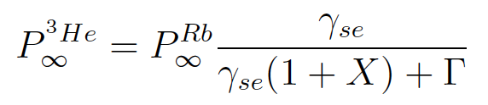
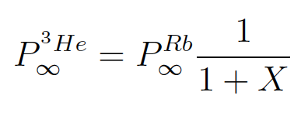
X Factor
E. Babcock et al. reported evidence of a previously unrecognized spin relaxation mechanism (Babcock, Chann, Walker, Chen and Gentile, PRL vol. 96, pg. 083003 (2006) ):
With infinite laser power
More on this later.
Notes:
Prior to the introduction of the X factor, it was not understood why 3He polarization would not approach unity with suciently high alkali-vapor densities and laser power
such that PA was nearly 100%.
X appears to be temperature dependent and roughly proportional to alkali density. X limits the maximally achievable 3He polarization even with infinite laser power.

Slide 10
Adiabatic fast passage (afp)
Helmholtz Coil
Oven
Holding Field:
Target Cell
RF field:
x
y
z
In rotating frame:
RF Coil
Notes:
The oscillating field can be decomposed into two counterrotating components with the same amplitude B1

Slide 11
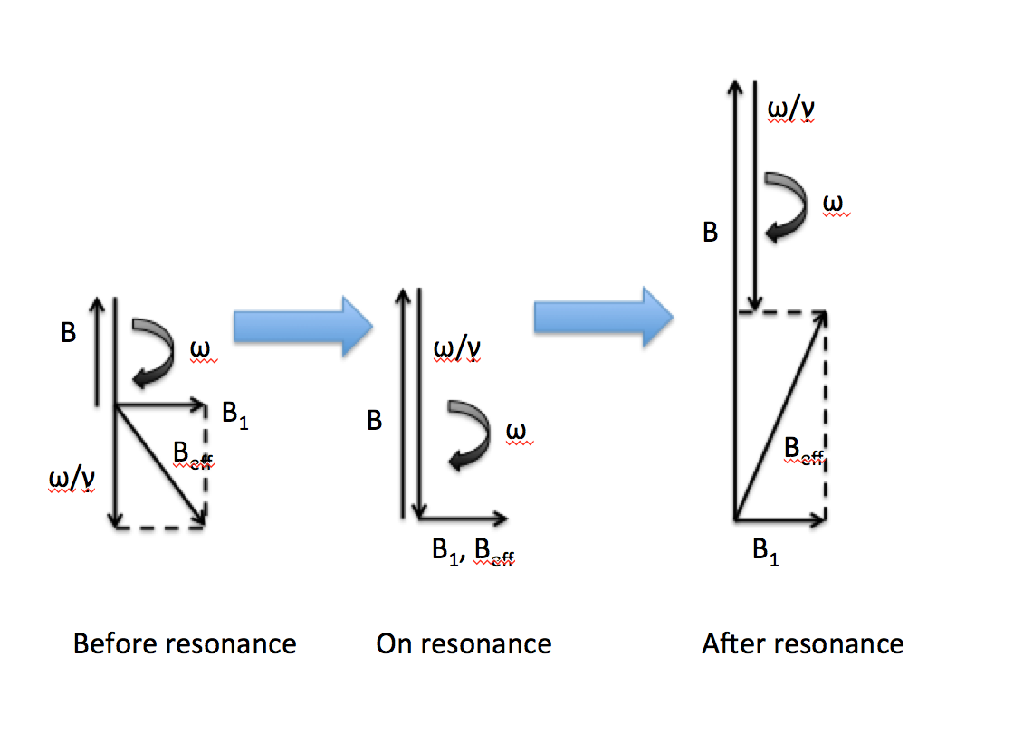
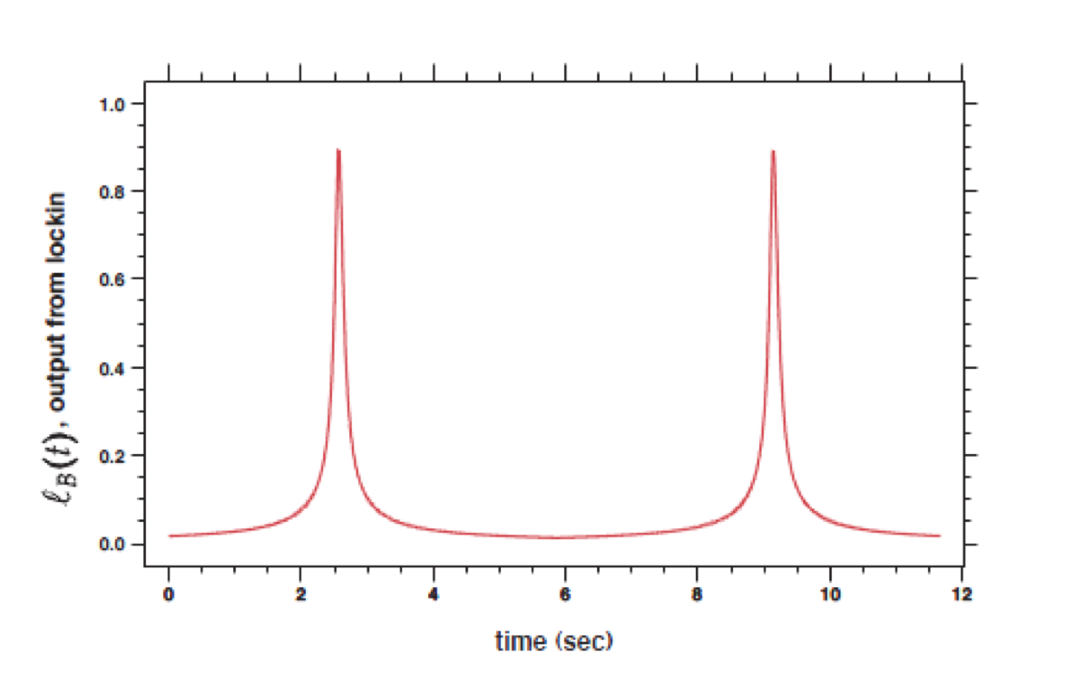
Adiabatic fast passage
During a field-sweeping AFP measurement

Slide 12
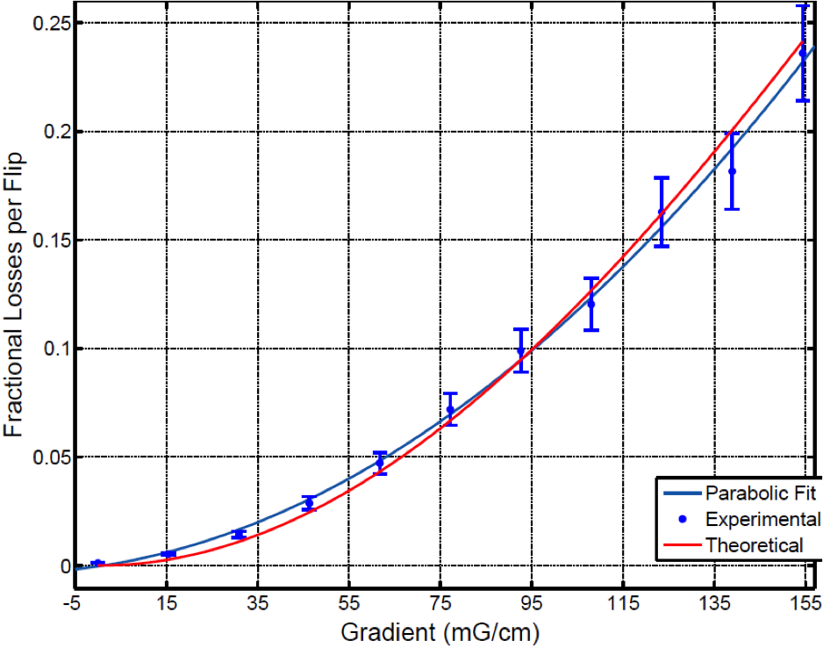
AFP losses
Longitudinal spin-relaxation rate on resonance
Fractional relaxation due to a single AFP flip
Measurements and theory agree extremely well
Notes:
Based on our understanding on losses caused by measurements, we were able to position the cell so that losses will remain acceptable.

Slide 13
Pulsed nuclear magnetic resonance (pnmr)
A short pulse of RF field is applied on a small region of the target
The frequency of the pulse is equal to the Larmor frequency, so in the rotating frame
A typical free induction decay (FID) is shown below:
Notes:
Typically for us, the dominating relaxation process is due to holding field inhomogeneities.

Slide 14
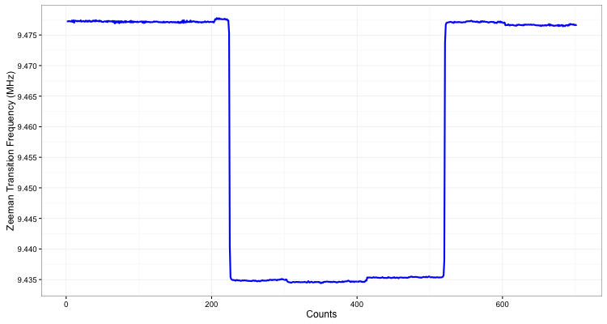
Electron paramagnetic resonance (epr)
The shift of Zeeman splitting of alkali metal is largely caused by Fermi-contact interaction
The effective field causing the shift is produced by polarized ³He multiplied by an enhancement factor
By flipping ³He spins, we can isolate the effective field from holding field and other ambient fields
Thus ³He polarization can be calculated using the frequency shift
Notes:
K: nuclear spin of the noble gas nucleus
S: electron spin of the alkali metal
The value of 0 can be thought of as an enhancement due to attraction of the alkali electron wave function to the 3He nucleus

Slide 15
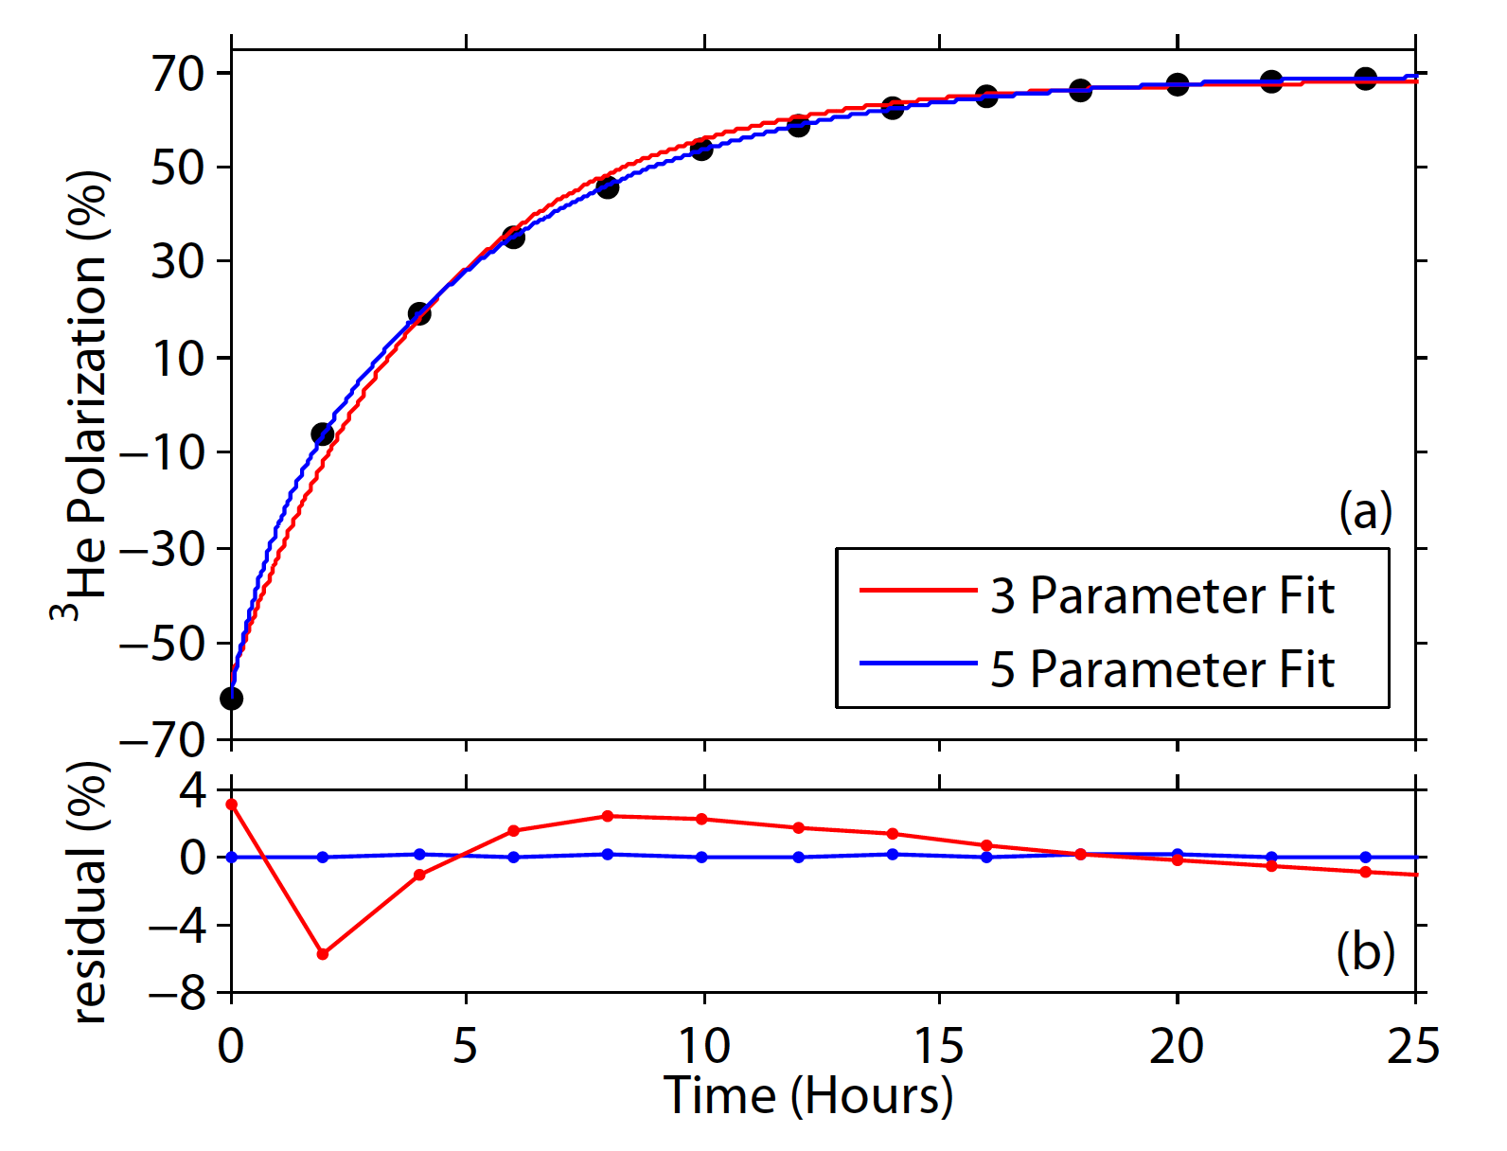
Spinup
Time evolution of polarization in a double-chambered cell:
Notes:
3 parameter fit is done with equation for single-chambered target cell
Y axis is polarization because the AFP signals have been calibrated with EPR

Slide 16
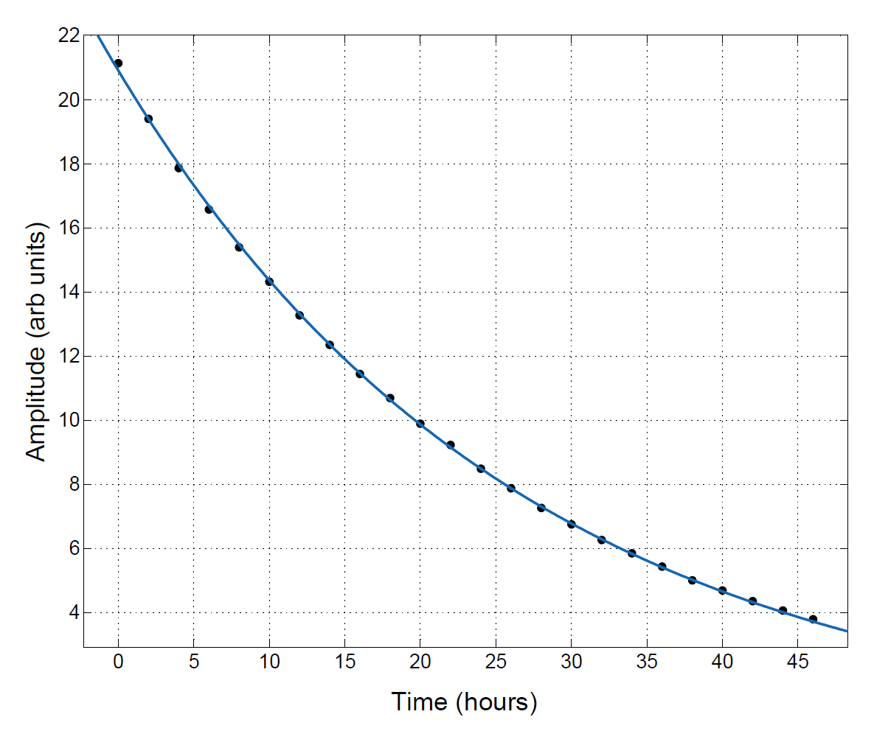
spindown
A spindown curve at room temperature
Exponential decay of nuclear polarization:
T₁ is the so-called life time.
Notes:
Y axis is raw amplitudes from AFP measurements.

Slide 17
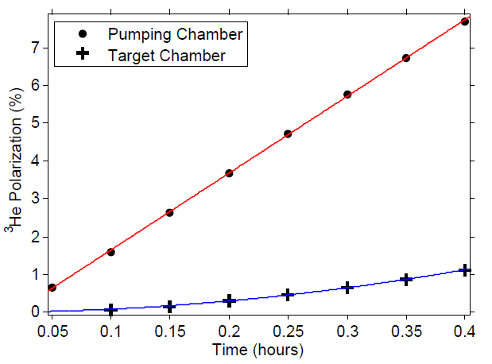
Initial spinup
By performing a Taylor expansion on the time evolution of polarization:

Slide 18
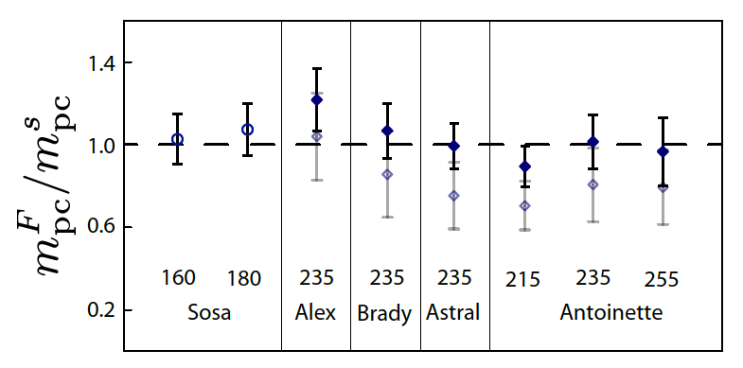
The k-³he spin-exchange rate constant
The quantity m_{pc} can also be measured with a technique based on Faraday rotation
Both m_{pc} values should agree, fitting the ratio to one provides a way to calculate the K-³He spin-exchange rate constant
Notes:
The numbers above the cell names are the oven set temperatures at which the measurements were made.
Open diamonds are results calculated with kseK reported by Babcock. Solid diamonds are our own results.

Slide 19
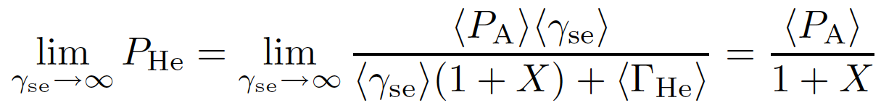
Maximum achievable ³He polarization
The so-called X factor characterizes a poorly understood temperature-dependent spin-relaxation mechanism that limits the maximum polarization
The relaxation mechanism described by the X factor has been observed to be roughly proportional to the spin-exchange rate, so it cannot be overwhelmed with infinite laser power.
Babcock, Chann, Walker, Chen and Gentile
PRL vol. 96, pg. 083003 (2006)

Slide 20
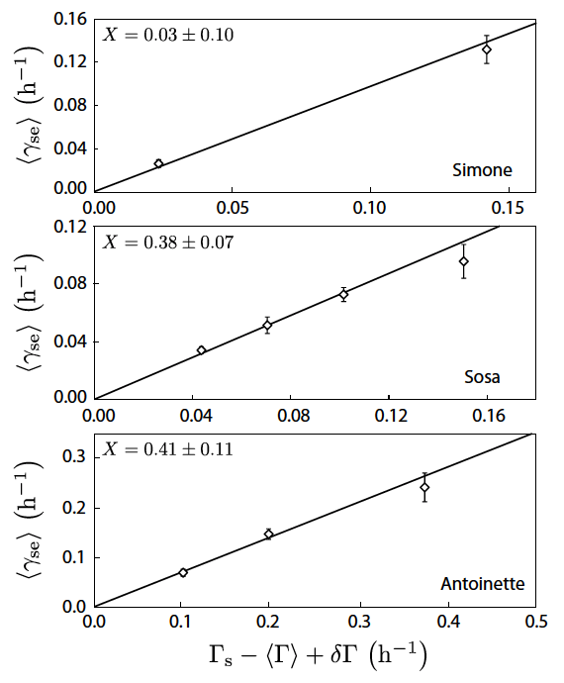
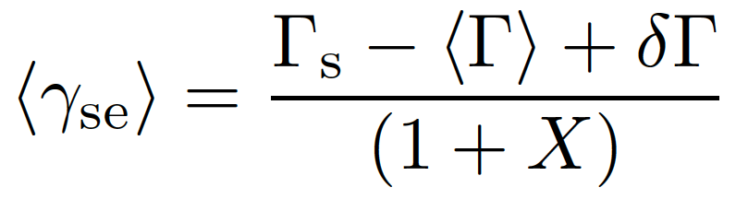
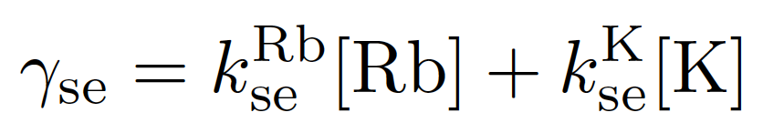
The x factor hot relaxation method
“The hot relaxation method” is a method of measuring the X factor by looking at spin-relaxation rates at different temperatures [1].
Measured with spinups and cold spindowns.
Determined with measured alkali densities and known spin-exchange coefficients
[1]E. Babcock, B. Chann, T. G. Walker, W. C. Chen, and T. R. Gentile, Phys. Rev. Lett. 96, 083003 (2006).

Slide 21
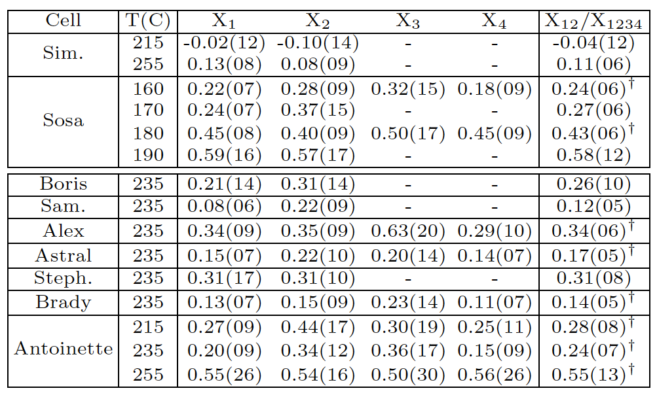
The x factor Single temperature methods
X factor can also be determined with data from a single temperature using various methods.

Slide 22
Errors and weighted average
Error for each determination of X:
To combine different determinations of X, a weighted average was obtained for which the weights are varied until the combined error is minimized

Slide 23
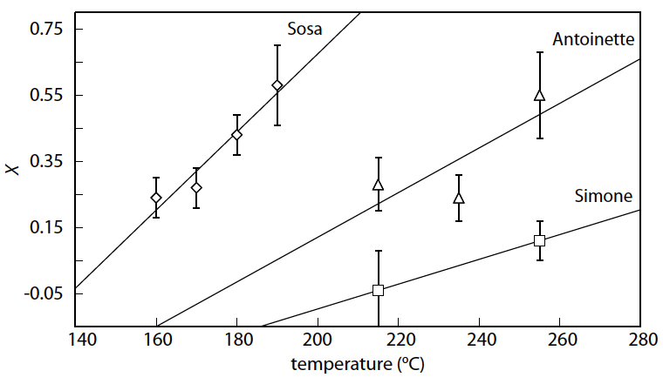
Possible temperature dependence
Our evidence suggests there may be temperature dependence in the X factor.

Slide 24
Metal end windows
Maximum beam current used during the 6 GeV era at JLab was 15 μA.
Future experiments during the 12 GeV era plan to use up to 60 μA.
Glass windows are not likely to survive currents above 30 μA.
Thus higher luminosity experiments require the development of metal end windows for spin-exchange polarized ³He cells.
Results from Mainz show ~20 hr spin-relaxation time for ³He targets with gold incorporated
Mainz tests did NOT involve alkali metals
Notes:
Next let’s about our studies on cells with metal parts. First I will talk about our motivation.
Mainz used metastability-exchange polarized ³He

Slide 25
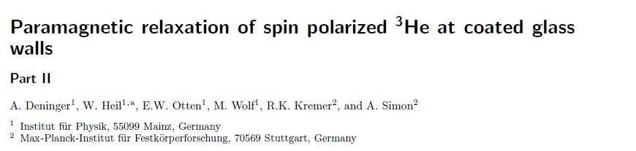
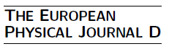
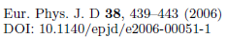
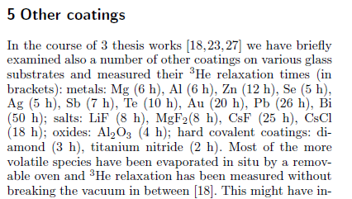
Mainz results
Gold measured at 20 hours, which should be more than enough.

Slide 26
New cell design with metal end windows
Notes:
You may notice the difference on transfer tubes compared to the target cell drawing I showed at the beginning.

Slide 27
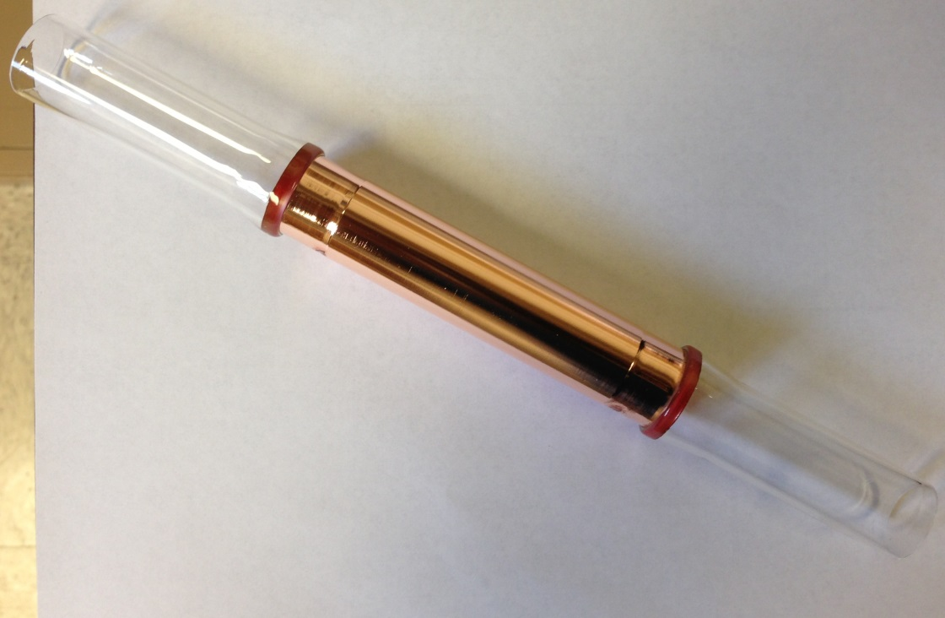
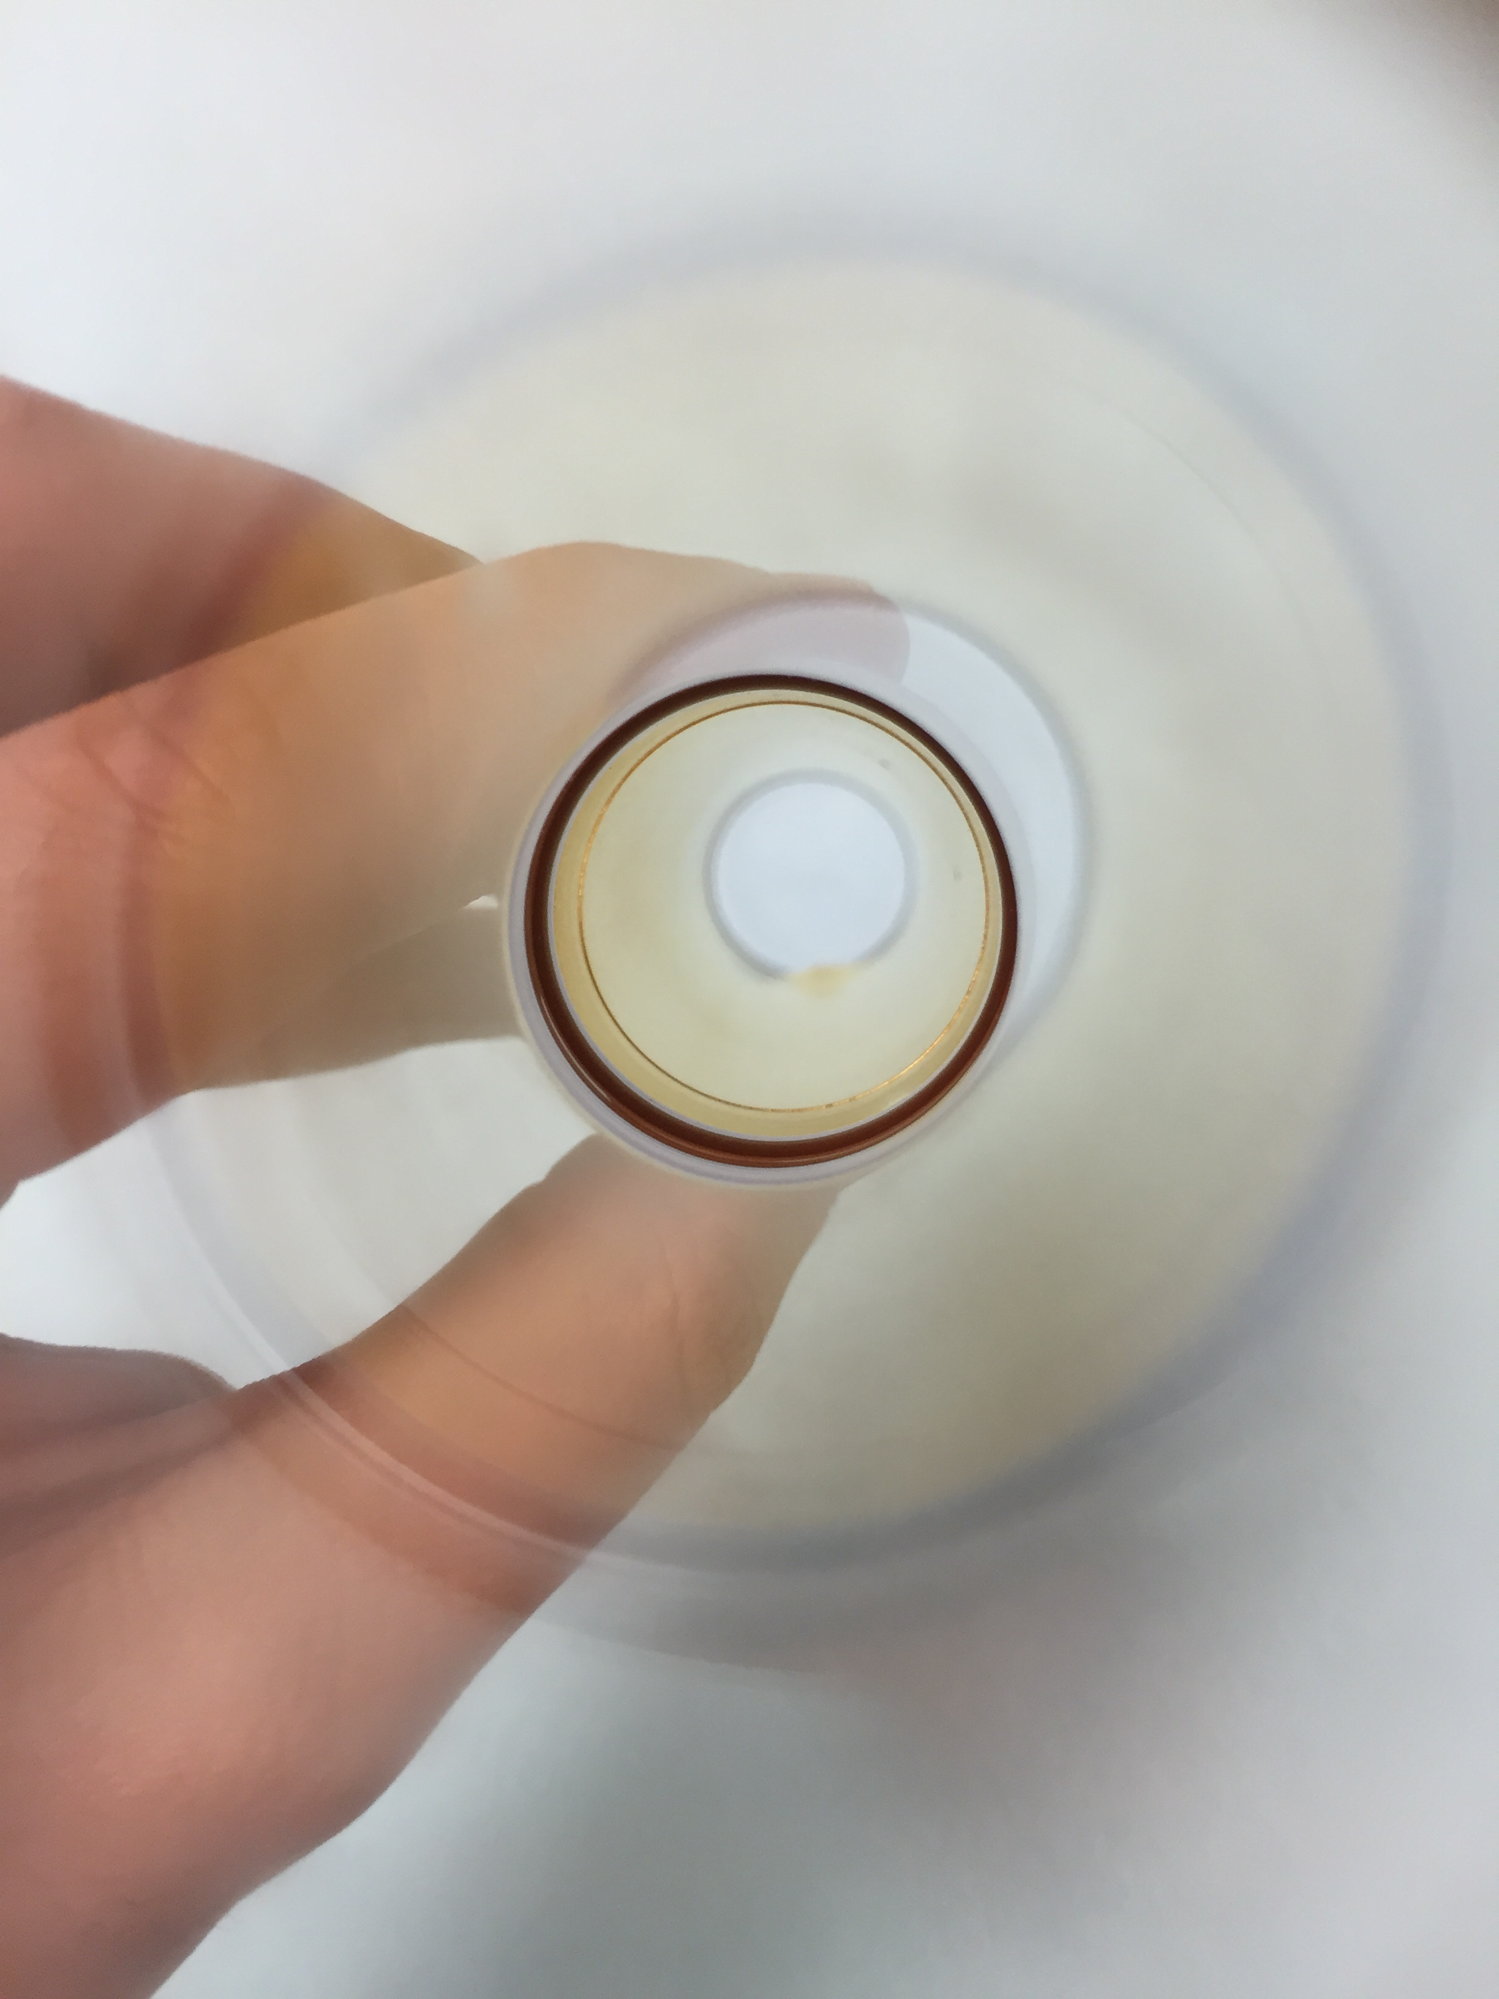
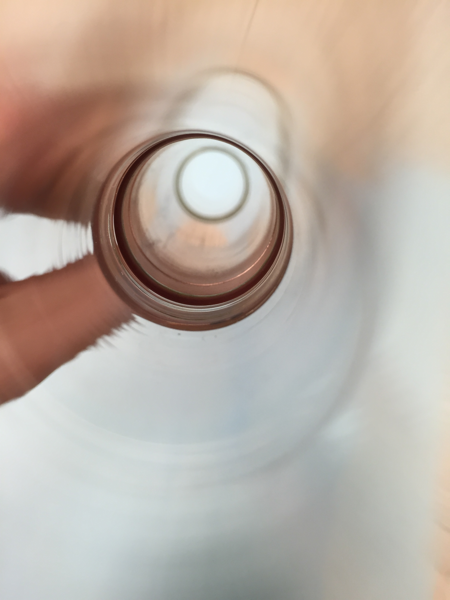
Metal cell fabrication
Glass-metal-glass seals made by Larson Electronic Glass
Mechanically polished by our machine shop
Electropolished by Able Electropolishing
Electroplated by Epner Technology Inc.
Cleaned with our ultrasonic cleaner
Made into test cells by Mike Souza, our glass blower
Filled to 1atm (³He + N₂₎
Houskeeper seals by Larson
Gold coated tube (left) vs. bare oxygen-free high thermal conductivity (OFHC) copper tube (right)
Notes:
5”x1”

Slide 28
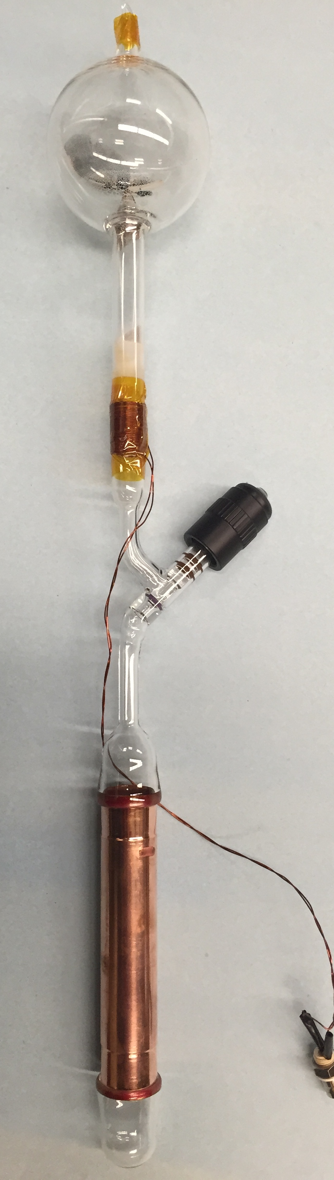
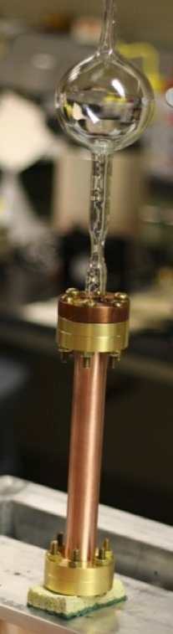
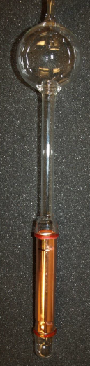
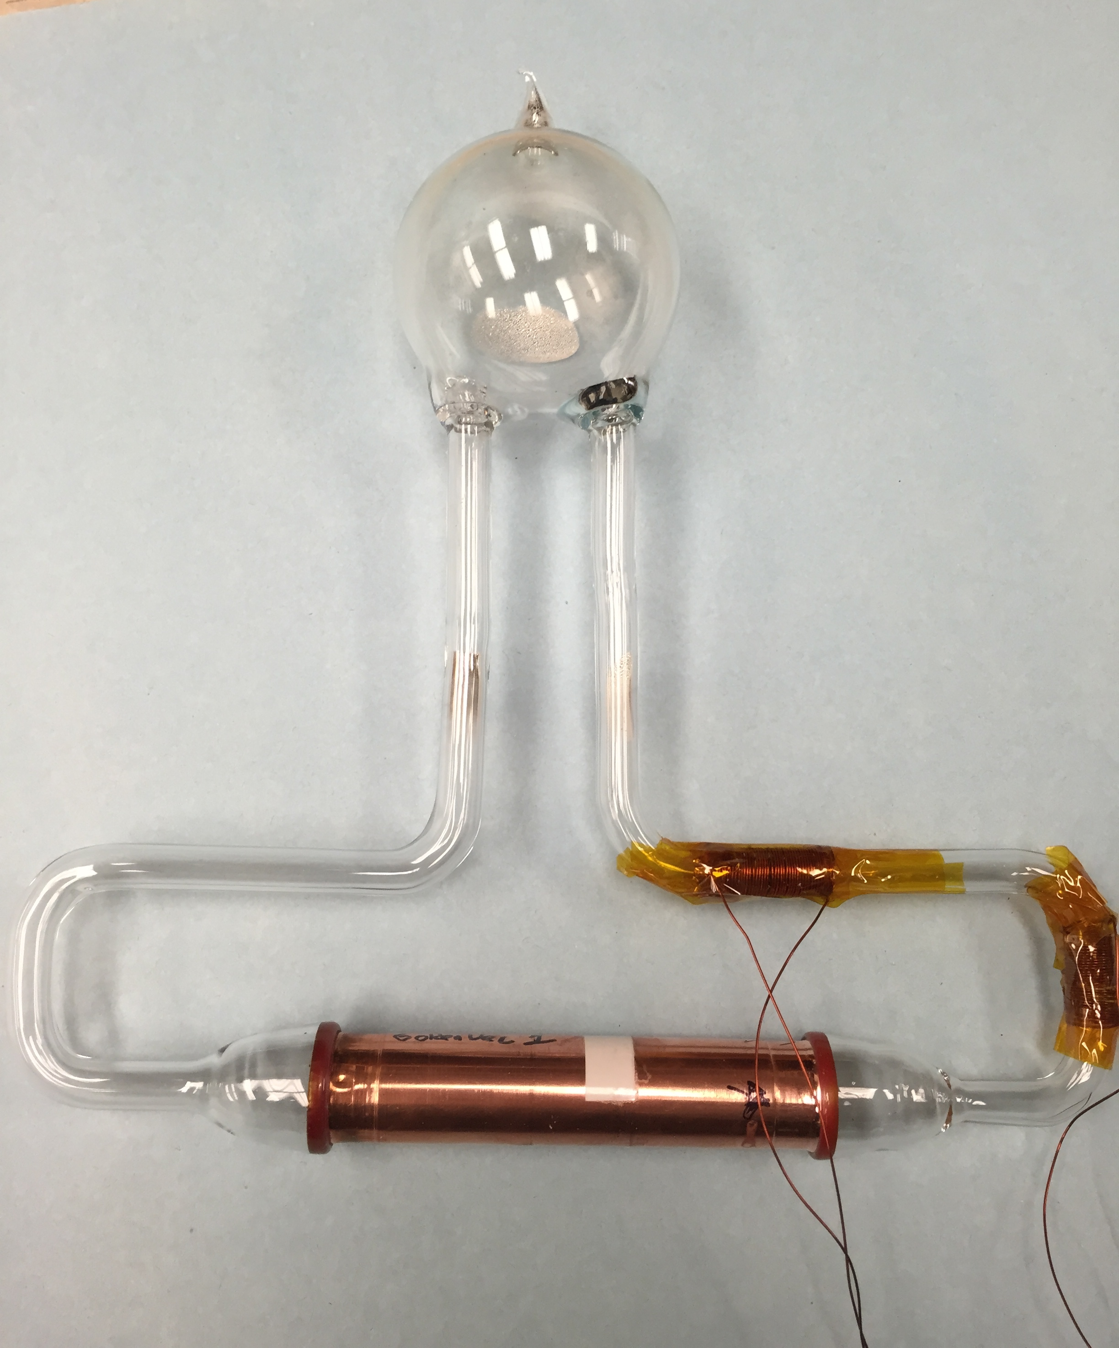
METAL CELLS WITH OFHC COPPER
Goldfinger
Cupid
Gold Rush
GoldenVec 1
GoldenVec 2
Spool piece
GoldenEye

Slide 29
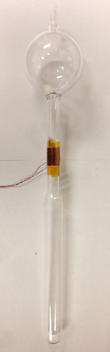
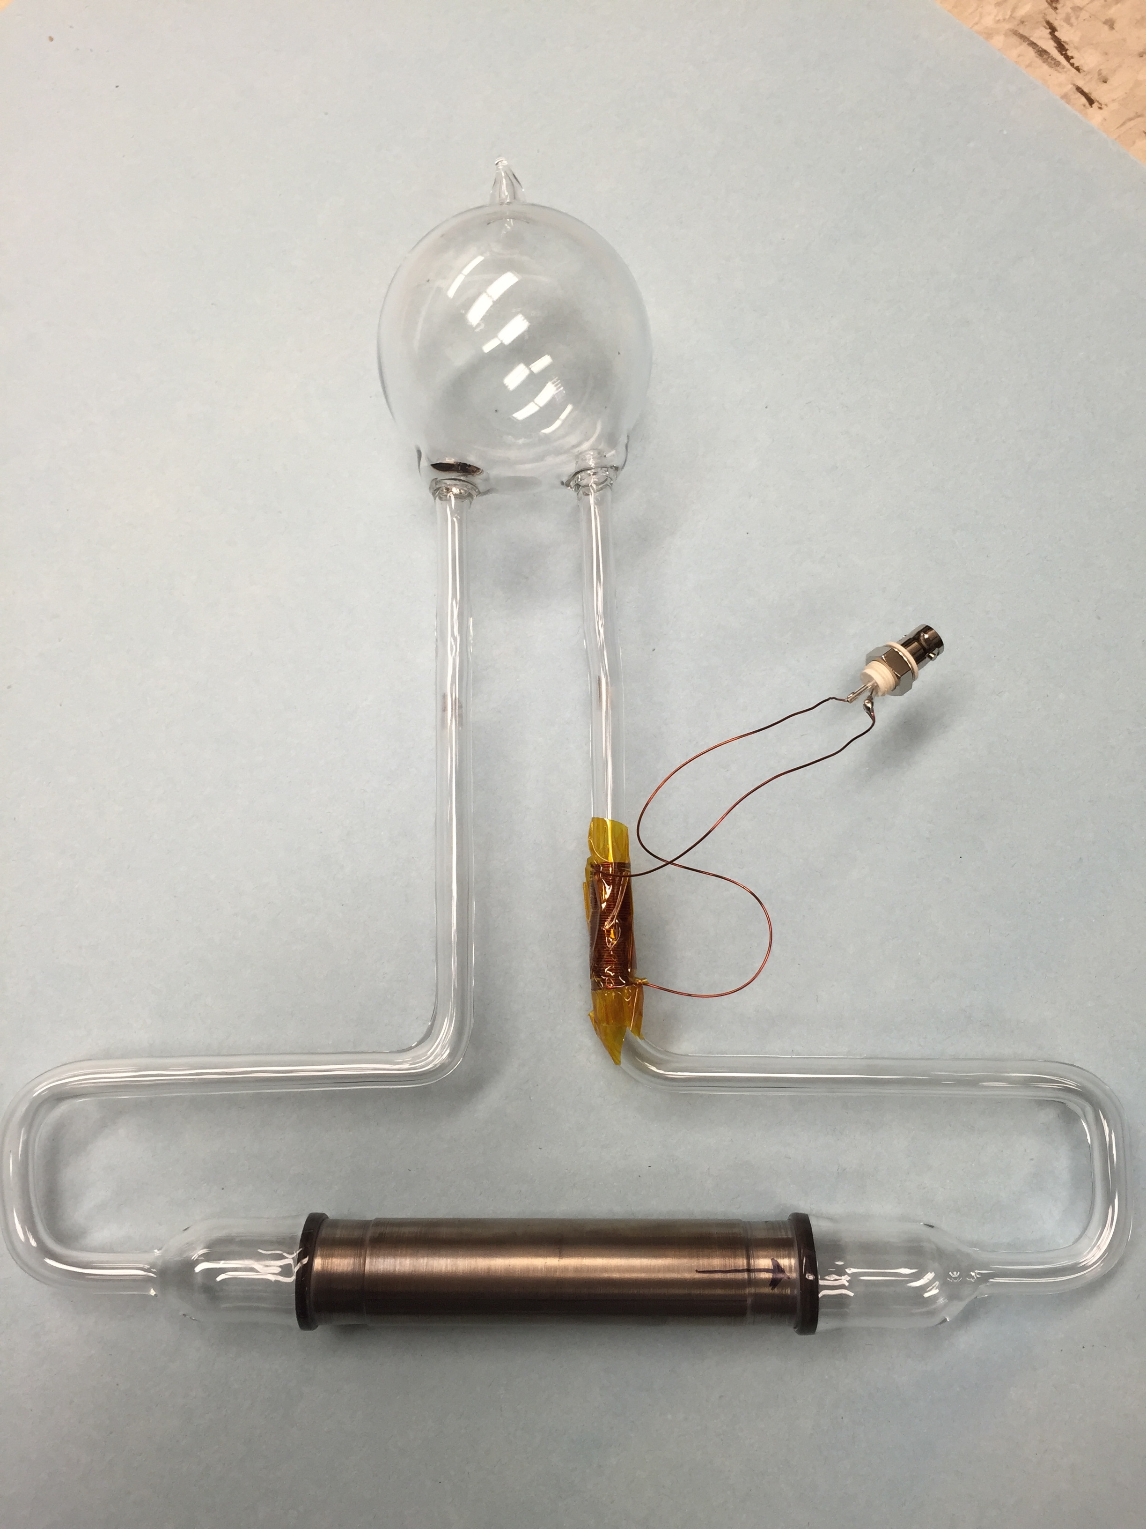
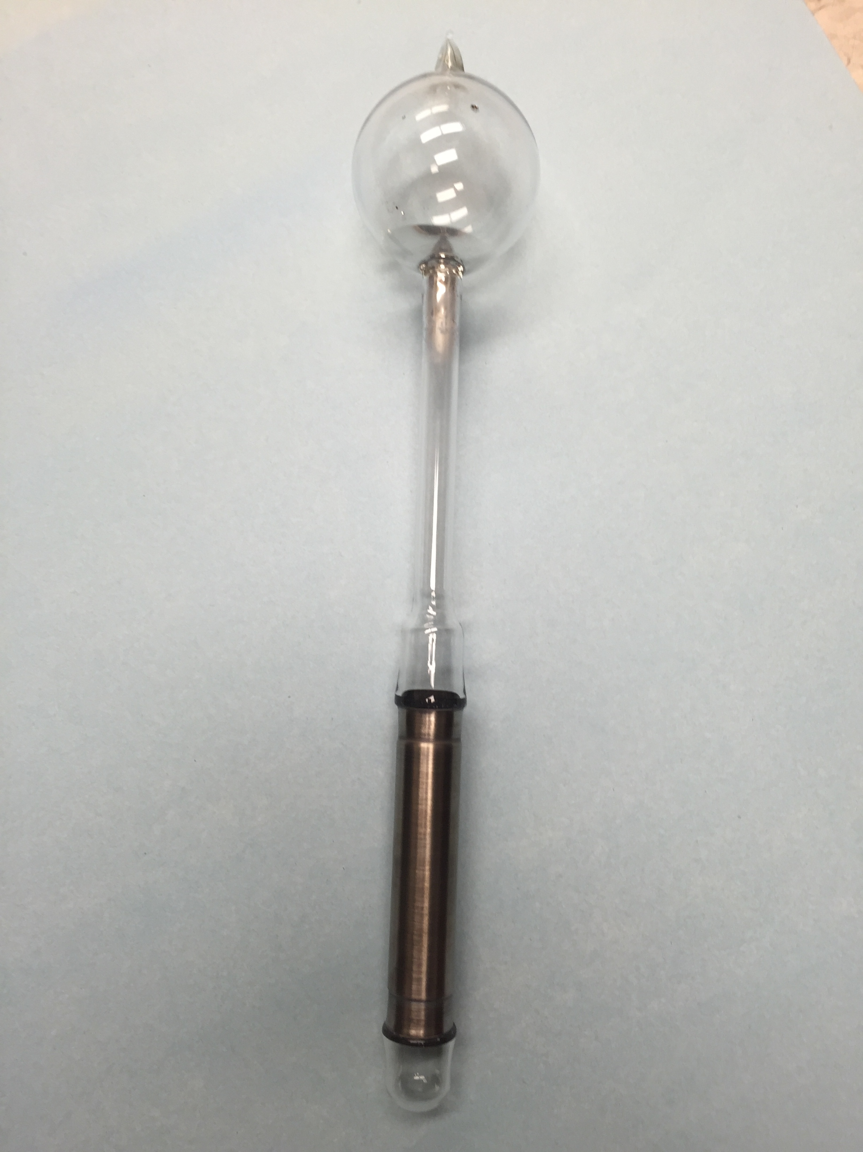
Cells with other materials
Pyrah
(Control Cell)
TitanVec
Titan

Slide 30
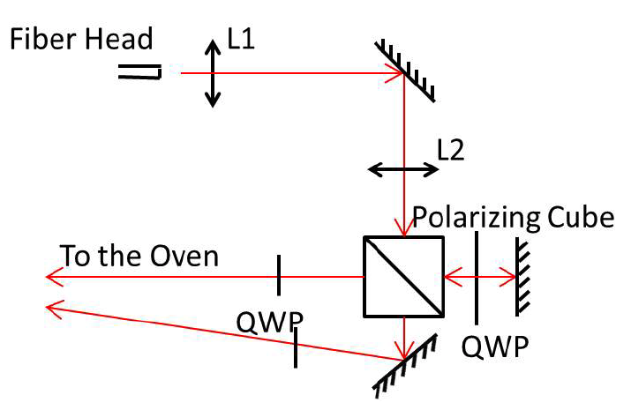
Experimental setup: Optics
Oven heated to 170ºC
³He test cell polarized using SEOP
Laser and holding field
Hand-wrapped pick up coil

Slide 31
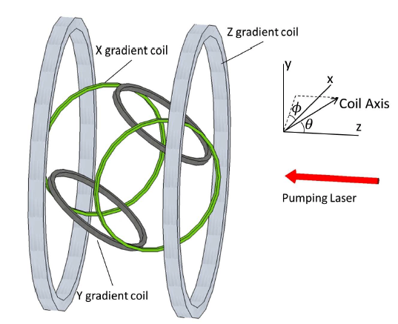
Experimental setup: Gradient coils
The gradient tensor at the center is:
The last column is the most important.
The orientations of the three sets of gradients coils are chosen such that each of them controls one component of the holding field gradients.

Slide 32
Magic angle
Magic angle: Θ_{m}=cos⁻¹1/√3=54.7º
With theses angles, each set of gradient coils has one nonzero value in the third column.
The gradient coils are critical for obtaining FID signals with long transverse relaxation time and high signal-to-noise.

Slide 33
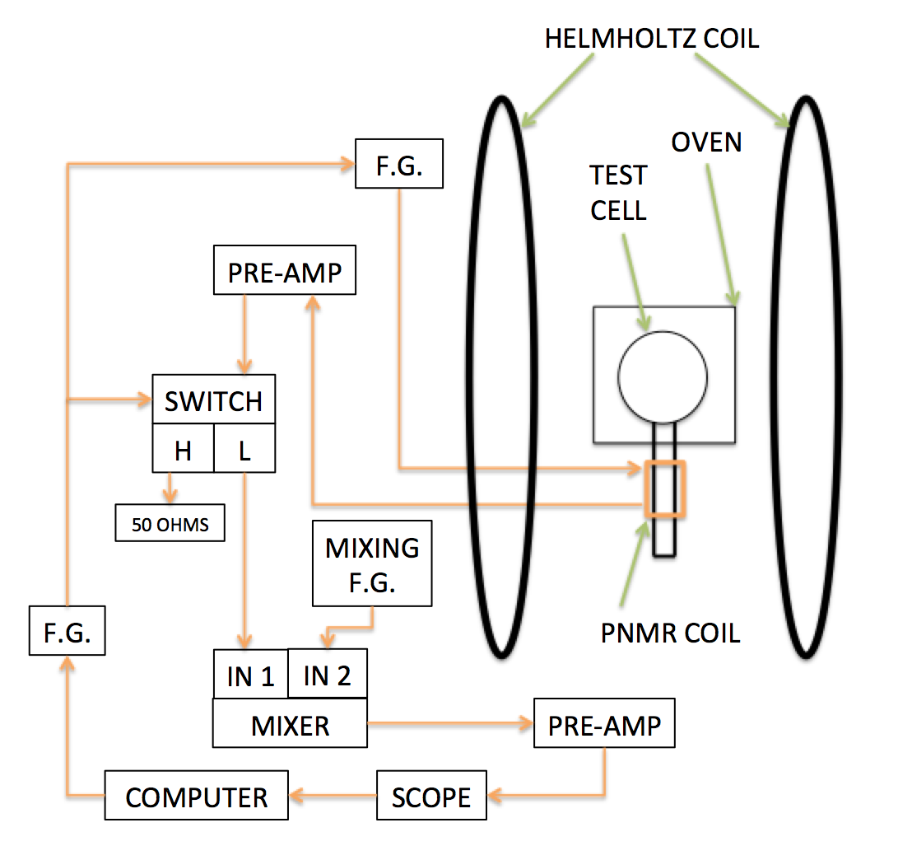
Experimental setup: PNMR setup
The pickup coil was lower than the center of the field
Settings of gradient coils require tweaking

Slide 34
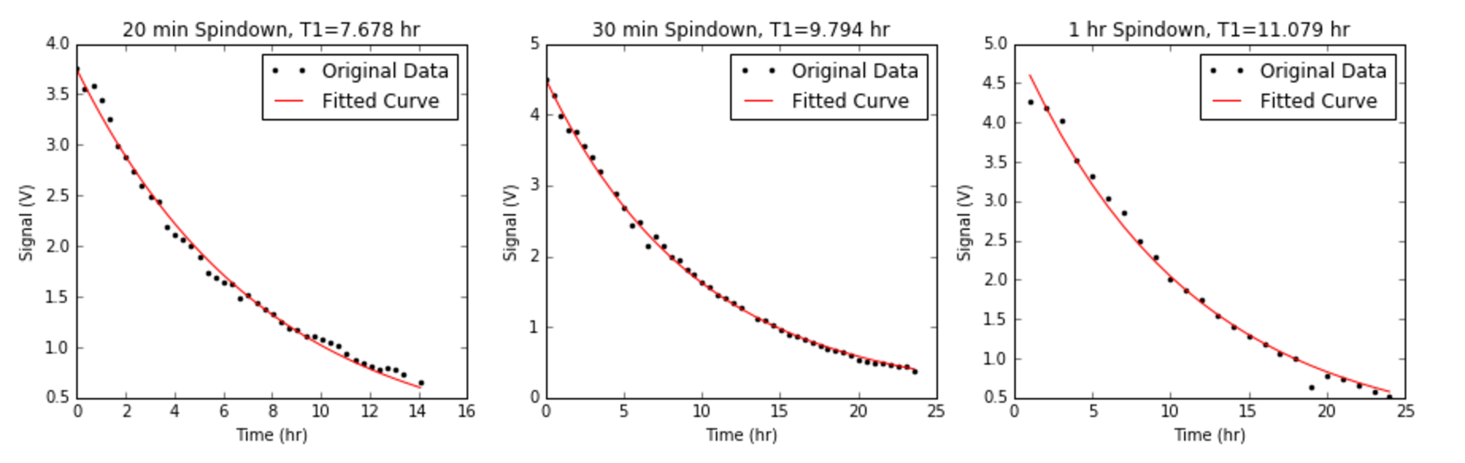
Spindowns with multiple sampling rates
3 Spindowns of GoldenVec1 each with a different sampling rate:
Notes:
For metal cell studies, we focused on spindowns for the most part as the spin relaxation rate was the most important characteristic. Thus it was important for us to extract the real time life of the cells without losses due to PNMR measurements.

Slide 35
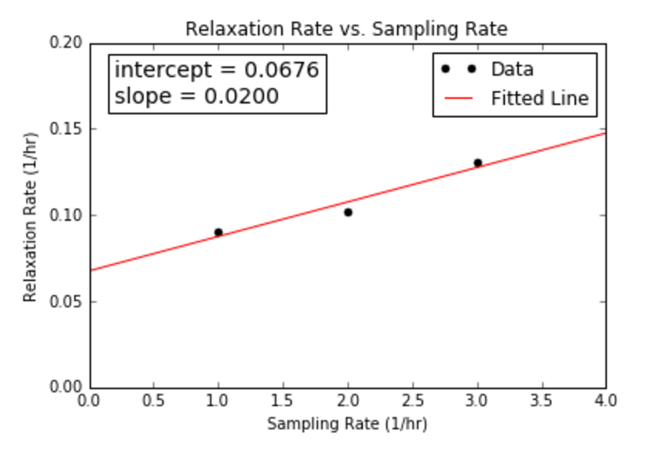
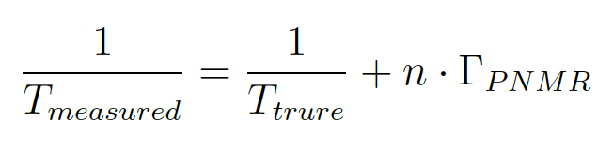
Extracting true lifetime
Linear fit of the three lifetimes to extract corrected lifetime and PNMR loss

Slide 36
Relaxation measurement results: tyrion
Tyrion was a spherical GE180 cell with gold coated on the interior surface.
Measured lifetime was 1.21 hr.
The short lifetime was attributed to impurities in the cell.
All other techniques explored to coat gold on glass directly were difficult.
Next step was to investigate gold coating on metal and bond the metal piece to glass.
Notes:
Having talked about the experimental setup and techniques, I will move on the to the results.

Slide 37
Relaxation measurement results: SPOOL PIECE
First cell with OFHC copper.
The OFHC copper tube was attached to a glass flange with o-rings for making the seal.
The 2.14 hr lifetime was attributed to outgassing from o-rings.
The lifetime of the separated PC was 109.2 hr.
New ways to bond metal to glass should be investigated.

Slide 38
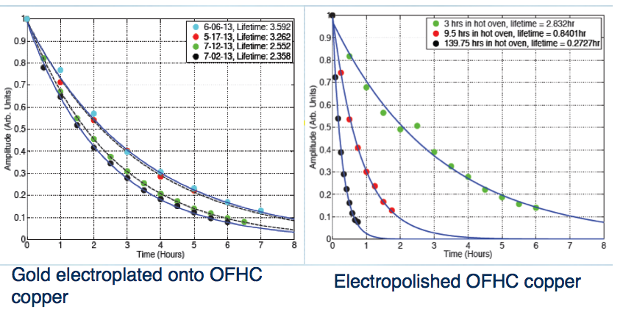
Vertical metal cells: goldfinger and cupid
All glass-metal seals from this point on were made with Houskeeper seal by Larson Electronic Glass.
First two cells showed degradation of lifetime.
Cupid degraded from 3.6 hr to 2.4 hr
Goldfinger degraded from 2.8 hr to 0.3 hr
Rb forms amalgam with metal
Notes:
Explain what I mean by vertical metal cells

Slide 39
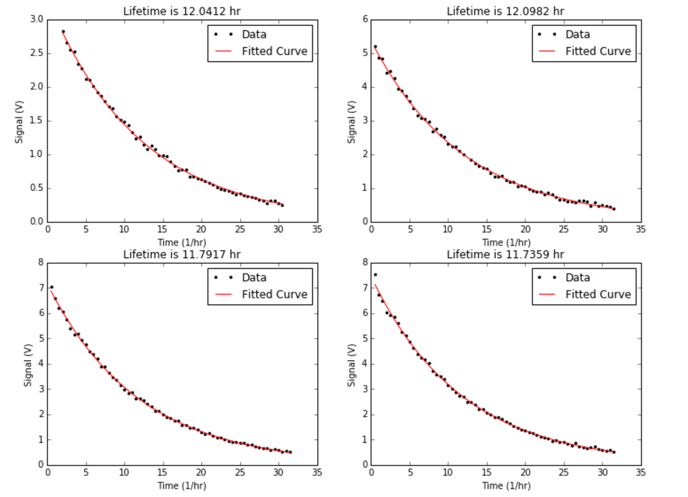
Vertical metal cells: goldrush
Our first gold coated cell with more than 10 hr lifetime.
Notes:
Because Goldfinger had a leak during the filling process, we decided to test with the same design.

Slide 40
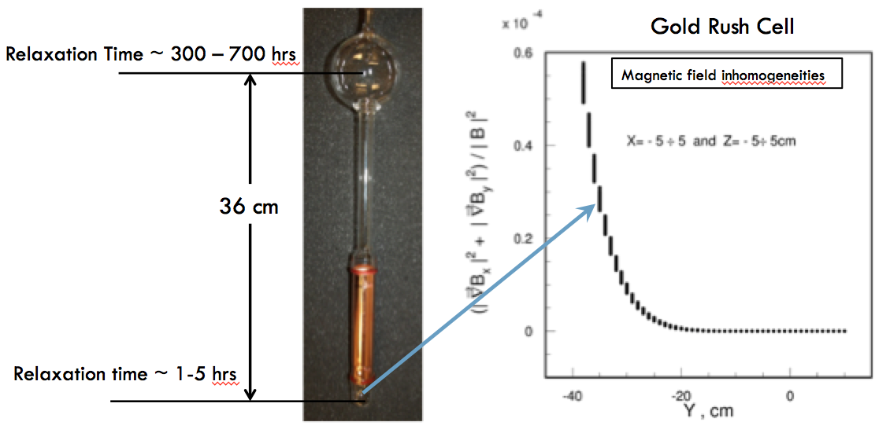
Effects of field inhomogeneities
The lifetime increased from roughly12 hr to 14.81 hr after elevated by 10 cm.
Notes:
However, we were not able to lift the cell further more because of the spatial constraint.

Slide 41
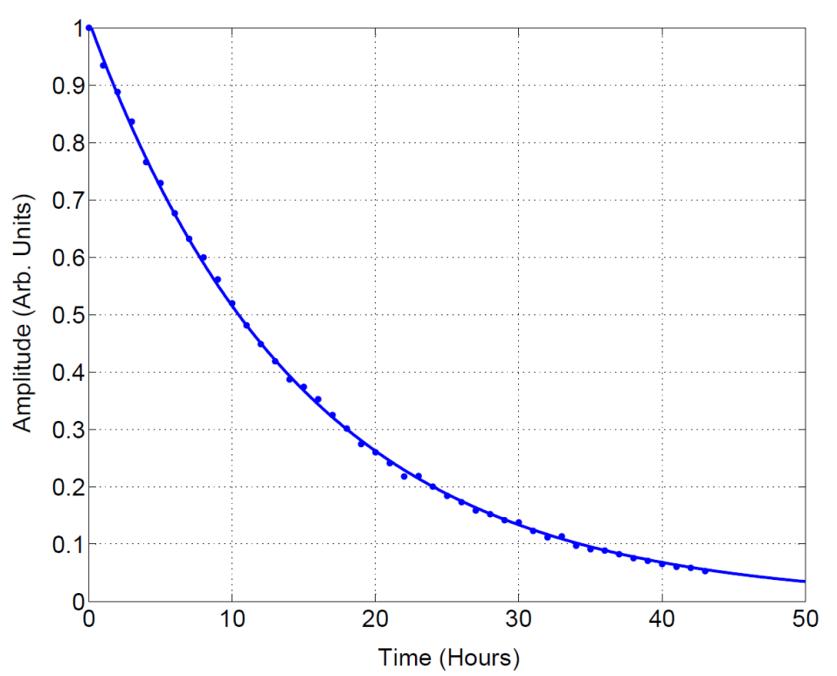
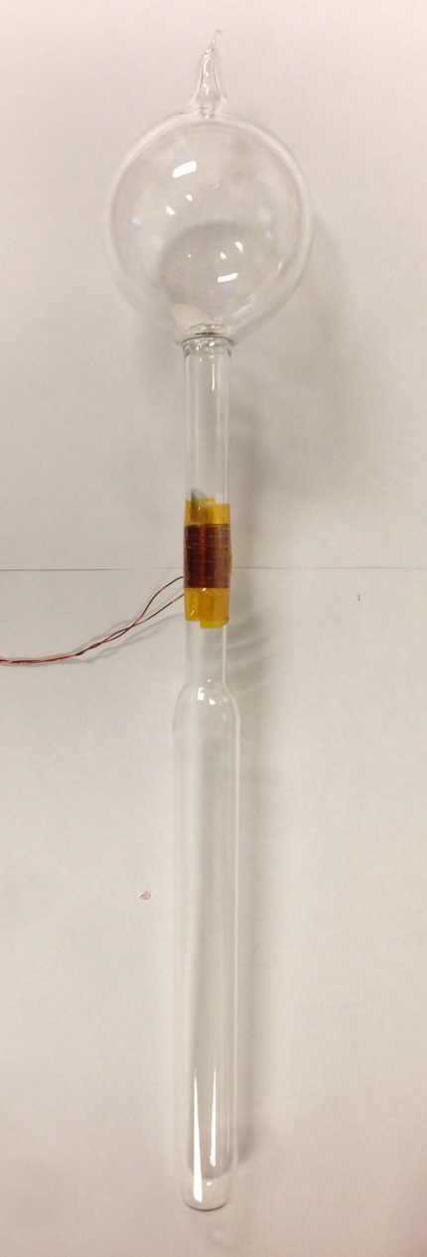
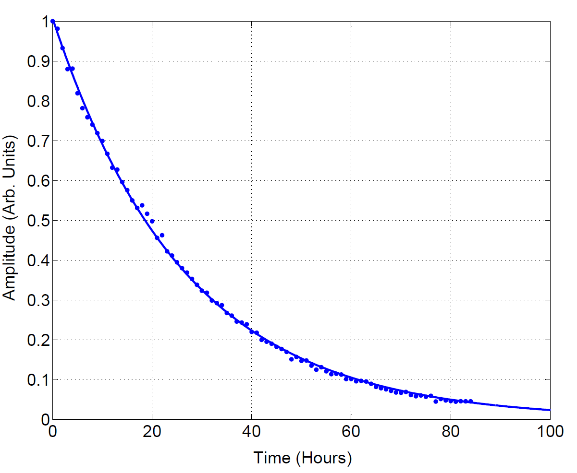
pure pyrex control cell: pyrah
Goldrush after elevation:
14.81 hr
Pyrah after elevation:
26.5 hr
Notes:
Since Pyrah had the same dimensions as Goldrush, a direct comparison suggested the additional relaxation rate due to the metal tube was around 1=25 hr.

Slide 42
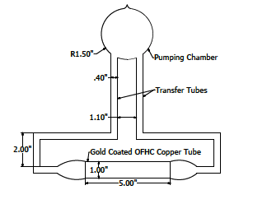
Horizontal cells: goldenvec
Design of horizontal cell:
Goldenvec had a lifetime of 10.6 hr.
Overall vertical length reduced from 15.75’’ to roughly 10’’.

Slide 43
goldenvec2
Same design as Goldenvec.
Filled with cryogenic trap instead of noble gas purifier because of the success with Protovec2.
Lifetime increased to 15.6 hr, longest we have to date.
All metal cells afterwards were filled with cryogenic trap.
Notes:
Briefly introduce cryogenic trap.

Slide 44
Ge180 cells: goldenvec180 and goldenvec360
It was widely acknowledged that GE180 had less wall relaxation compared to Pyrex.
Goldenvec180 and Goldenvec360 followed the same design as Goldenvec.
Corning 7052 was used as the transition glass to bond OFHC copper to GE180.
Measured lifetime was 4.43 hr for Goldenvec180 and 3.01 hr for Goldenvec360.
Was it the transition glass, the melt of GE180 or insufficient annealing?
Notes:
Time to move on to GE180.

Slide 45
Test on transition glass
Two test cells were made with canary glass (uranium glass) because of our previous experience with it.
One cell had vertical configuration with Pyrex and one had horizontal configuration with GE180.
Pyrex cell had 22.7 hr lifetime even though uranium is paramagnetic.
GE180 cell was prepared the same way as Goldenvec2 and had 6.39 hr lifetime without metal.
Problem is likely to be directly related to GE180 itself!
Notes:
Uranium is paramagnetic, but gave long enough lifetime.

Slide 46
The glass or the annealing
A spherical GE180 cell was made.
The measured lifetime was 72 hr so it’s not the glass itself.
Was it due to insufficient annealing?
The glass directly attached to metal was not placed in oven for annealing.
Spliced to the cell after the rest of the cell was baked.

Slide 47
Goldfinger180
A GE180 with vertical configuration was made.
Our glassblower minimized the amount of glass that was not placed in oven.
The top Houskeeper seal was leaking. The epoxy type sealant Stycast 1266 was used to fix it.
The lifetime was 10.4 hr before elevation, and 12.4 hr after elevation.
Metal end windows are predicted to contribute less than 1/100 hr⁻¹ relaxation rate.
Proper annealing is very important!
We have developed techniques to incorporate metal without introducing significant relaxation!

Slide 48
Pyrex cells with titanium
Titan was a Pyrex cell with titanium tube and vertical configuration.
Its lifetime was so short that no spindown was obtained.

Slide 49
Pyrex cells with titanium
Titanvec was a horizontal Pyrex cell with gold-coated titanium tube.
Gold started to peel off of titanium tube during ultrasonic cleaning.
The measured lifetime was 0.52 hr.

Slide 50
Thank you!

Slide 51
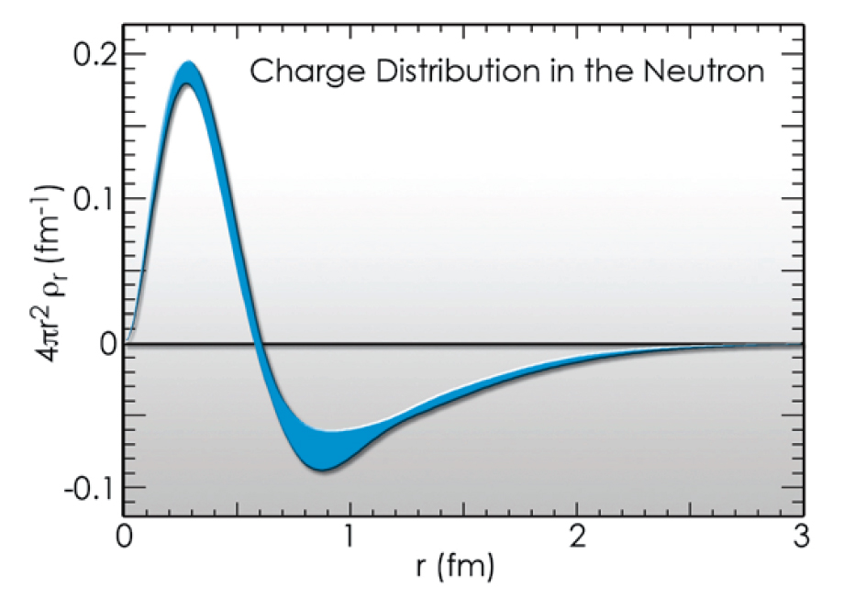
Elastic form factor of neutron
The Fourier transform of elastic form factor provides information of the charge distribution inside neutron.
Core is positive and “proton like”
Core is surrounded by negative pion cloud
Notes:
F(q^2)=integral rho(R->)exp(i q-> R->) dR->
How to relate form factor and 3He targets

Slide 52
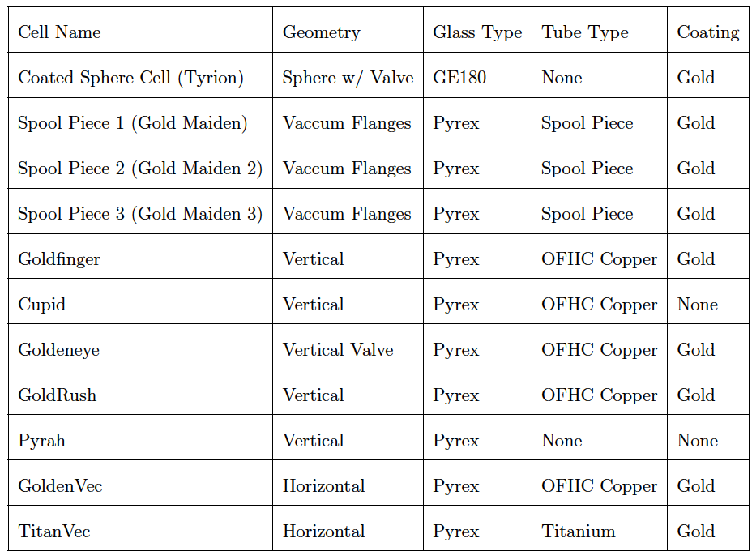
Backup slides metal cell table

Slide 53

backup slides metal cell table

Slide 54


Backup slide metal cell lifetime table

Slide 55


Backup slides cryogenic trap

